Slide 1
IMPLEMENTING ZERO PCB PART 2
SUBMITTED BY : AMANDEEP SINGH (C0761298)
GROUP : 2

Slide 2
INTRODUCTION TO PCB
Printed circuit boards (PCBs) are the boards that are used as the base in most electronics – both as a physical support piece and as the wiring area for the surface-mounted and socketed components. PCBs are mostly made from fiberglass, composite epoxy, or another composite material.
PCB contains electrical traces, paths that connects the various components placed on it.

Slide 3
TYPES OF PCB
There are various types of PCB available in the market.
Single sided PCB: Contains substrate on one side of the layer and this layer is coated with the metal that is has good conductivity like copper. These PCBs are utilized for simple circuits such as power sensors, relays, sensors and electronic toys.
Double sided PCB : Double sided PCBs have both the sides of the substrate featuring metal conductive layer. Holes in the circuit board allow the metal parts to be attached from one side to the other. These PCBs connect the circuits on the either side by either of the two mounting schemes, namely through-hole technology and surface mount technology

Slide 4
TYPES OF PCB
Multi-layer PCB : These are printed circuit boards, which comprise more than two copper layers. These PCBs play an important role in high-speed circuits
Some other types:
Rigid PCB
Flexible PCB
Rigid-flex PCB

Slide 5
ZERO PCB
General purpose PCB also known as dot or Perfboard.
It is thin rigid copper sheet with small dots.
These dots are equidistant to each other.
Spacing between the holes is 2.54mm.

Slide 6
ROLE OF HOLES
Holes provide the physical support to the components that we place at the board.
Once the components are placed connections are made.
Each hole is encircled by a round or square copper pad so that component lead can be inserted into the hole and soldered around the pad without short-circuiting the nearby pads and other leads. For connecting the lead of component with another lead, solder these together or join these using a suitable conducting wire.

Slide 7
REQUIREMENTS
Task is zero PCB implementation to accomplish this task connection is made between the components after placing them on the board. It requires few tools and the components used in the project.

Slide 8
REQUIREMENTS
Soldering Iron
Soldering Wire
Wires
Zero PCB
Multimeter
Headers

Slide 9
REQUIREMENTS
Touch Screen
GSM module
Motor
Buzzer
Arduino mega
Fingerprint sensor

Slide 10
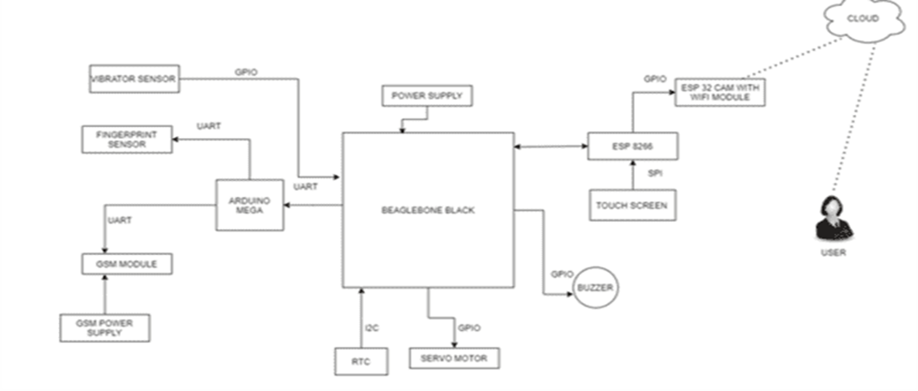
BLOCK DIAGRAM

Slide 11
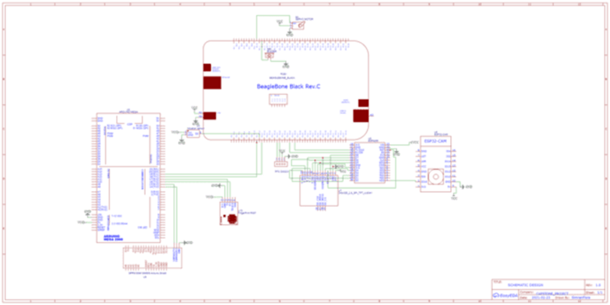
SCHEMATIC VIEW

Slide 12
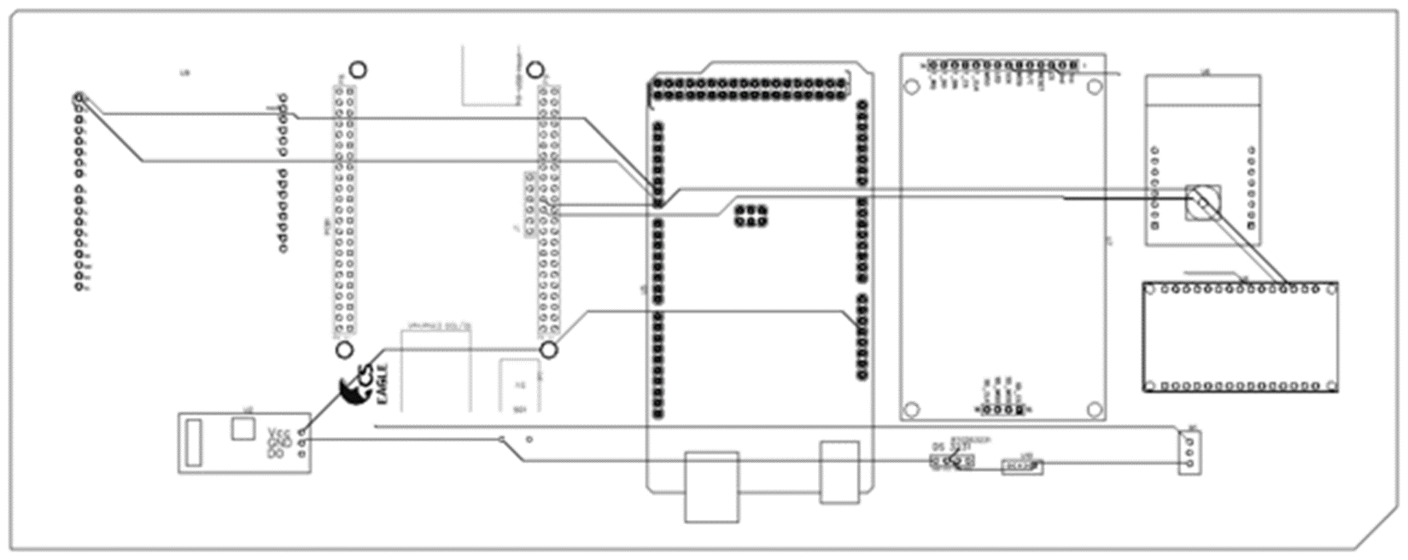
PCB DESIGN ONLINE

Slide 13
FIXING THE COMPONENTS ON THE BOARD
To fix the components soldering is done.
Soldering is an art that is an embedded engineer must possess to complete the hardware part of the project. This art requires some time to practice as good soldering is a quite challenging task.
Why one should acquire this art because this is the way by which one can connect the components physically and electrically.

Slide 14
SOLDERING
This task can further be divided onto three different parts and they are listed as below:
Collecting the material for the soldering.
Preparing for soldering.
Soldering PCB.

Slide 15
COLLECTING MATERIAL FOR THE SOLDERING
Basic tools required for the soldering are soldering iron and wire and here is the basic information regarding these components.
Soldering Iron: Lets first talk about the tip of the iron. It is the part of the iron the heats up when electricity is provided to the iron. Heated tip allows the solder to melt around the tip of the components. In some soldering irons we have the option to change the tip as well as these tips comes in various sizes.
Wand: AS we know the tip gets heated up when connected to supply so in order to hold the iron an insulated part as provided that is known as wand.

Slide 16
PREPARING TO SOLDER
Before we use the iron it must be tinned. "Tinning" is the process of coating a soldering tip with a thin coat of solder. This aids in heat transfer between the tip and the component you are soldering and gives the solder a base from which to flow from. For tinning these steps should be followed.
Heating up the iron: Iron must be heated up to the temperature at which it can easily melt the soldering wire. It is important if the iron is being used for the first time as Sometimes insulation is done to prevent the tip from the corrosion.

Slide 17
PREPARING TO SOLDER
Preparing palace to solder : Try to keep a piece of wood near when doing the soldering as sometimes the solder drips down. So, to make sure it does not harm anything.
Coating the tip completely: Tip should be coated properly. This is very important to so that the conductivity is there. If left uncovered, it may attract the flux residue that hinders the heating.

Slide 18
PREPARING TO SOLDER
Clean the soldering tip: Once its, made sure that the tip has been coated completely with the solder one should clean the tip using a sponge as it will lead to the flux residue around the tip.
So, these were some step need to be taken to keep the tip alright. This keeps the heat transfer up to the mark.

Slide 19

CLEANING THE SURFACE
Cleaning the surface before using it always a good practice. This will remove the any dirt on the surface.
If we want a strong solder with low resistivity always clean the surface.
Any industrial pad can be used for this purpose.

Slide 20
PLACING THE COMPONENTS
If the components are very few then one can place the components at once and solder them.
In case of more, number of components try to solder the flat and small components at first as this reduce the risk factor of damaging the components.
Place the leads of the components gently in the holes provided.
It’s a good practice to go through the schematic as this helps in placing the components at right place.

Slide 21
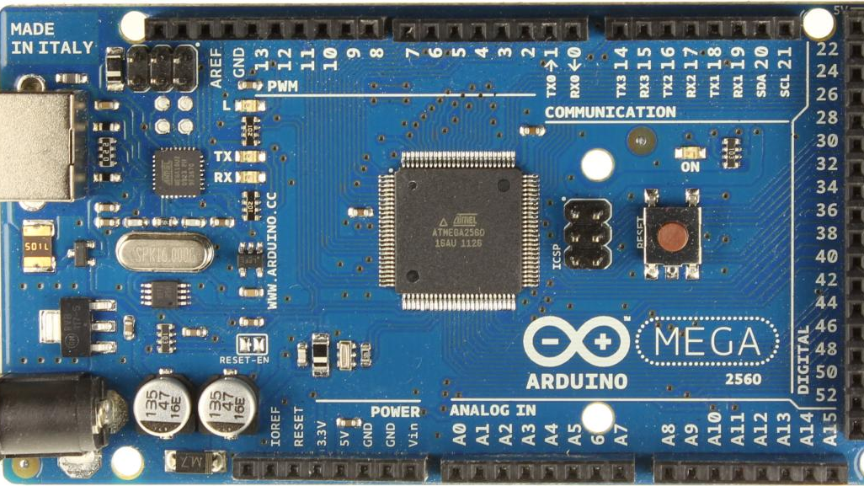
PLACING THE COMPONENTS
First component that we are soldering and placing on the PCB is the Arduino mega.
There are number of pins that are connected from the Arduino mega to the various modules
We need to solder pins 14 to 19 carefully as these are making connections to other components as well.
This Photo by Unknown Author is licensed under CC BY-SA-NC

Slide 22
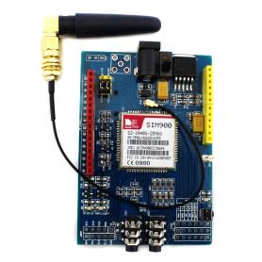
CONNECTIONS
GSM is connected to the Arduino mega with the uart protocol.
We are using GSM SIM 900 Module for this project to send SMS, when something wrong happen an email will be sent to the owner.
GSM need 5V power supply that is supplied by the 5V adaptor.
This Photo by Unknown Author is licensed under CC BY-SA
ARDUINO | GSM
PIN 15 | Tx
PIN 14 | Rx
GND | GND

Slide 23
CONNECTIONS
BUZZER | BEAGLEBONE
RED | P8.12
BAKCK | P8.2
Buzzer is directly connected to the beaglebone black with the help of GPIO pins.
Function of buzzer is to make sound when something wrong happens.

Slide 24
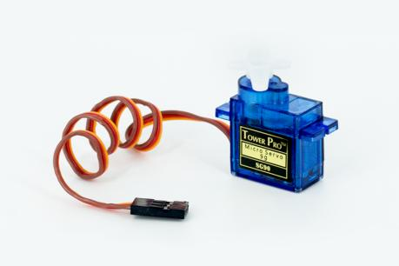
CONNECTIONS
Servo motor is connected directly to the beagle bone black with the help of GPIO pins.
SERVO MOTOR | B.EAGLEBONE BLACK
GND | P 8.2
VCC | P 9.7
PWM | P 8.10
This Photo by Unknown Author is licensed under CC BY-SA

Slide 25
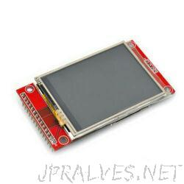
CONNECTIONS
Touch screen is connected with the ESP 8266.
TOUCH SCREEN | ESP 8266
VCC | 3.3
GND | GND
CS | D8
RESET | RST
DC | D4
SDI | D7
SCK | D5
LED | 3.3
SDD | D6

Slide 26
CONNECTIONS
ESP 8266 | TOUCHSCREEN
D5 | T_CLK
D2 | T_CS
D7 | T_DIN
D6 | T_DQ
D1 | T_DRQ

Slide 27
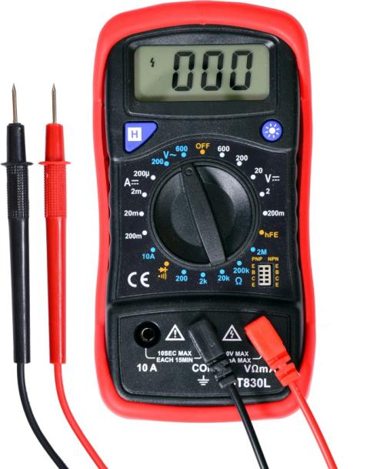
TESTING WITH MULTIMETER
You can also use the continuity function on your multimeter to test a solder joint. First, set your multimeter to continuity mode (looks like sound waves going out left to right in a cone shape). Touch the leads together and make sure the multimeter beeps.
CONTINUITY
FUNCTION
This Photo by Unknown Author is licensed under CC BY-SA-NC

Slide 28
TESTING WITH MULTIMETER
Now, touch the leads to two points on opposite sides of your solder joint. The multimeter will beep if there is continuity detected. This means that conductive material (i.e. your solder joint) is connecting the points between your leads and that the solder joint is good from a continuity standpoint. If the multimeter does not beep, you do not have continuity.
This Photo by Unknown Author is licensed under CC BY-SA-NC

Slide 29
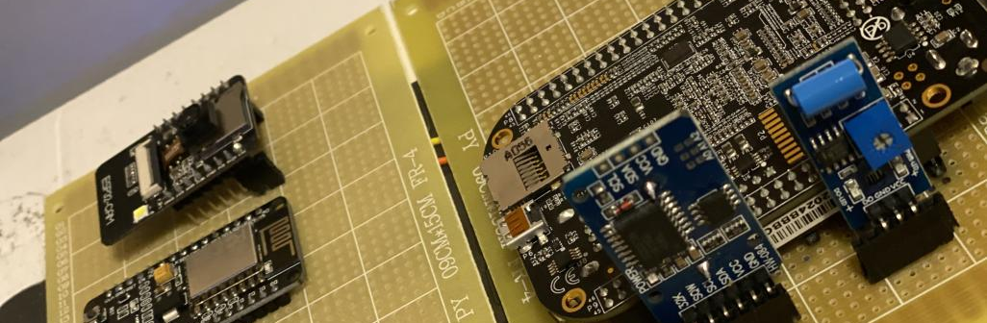
COMPONENTS ON THE PCB

Slide 30
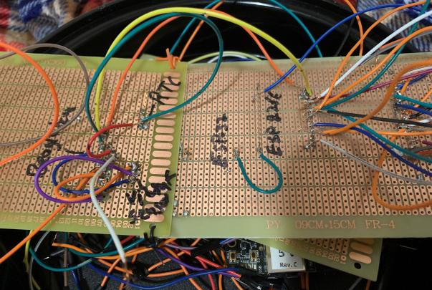
SOLDERING BOTTOM VIEW

Slide 31
REFERENCES
Comparison of general-purpose PCB and zero PCB
https://medium.com/@Graylogix/general-purpose-pcbs-f5ca0f09e99e
Feature of the Zero pcb
https://www.electronicsforu.com/technology-trends/learn-electronics/veroboard-zero-pcb-difference
Testing with the multimeter
https://multimeterexpert.com/use-multimeter-test-solder-joint/

